Slide 1



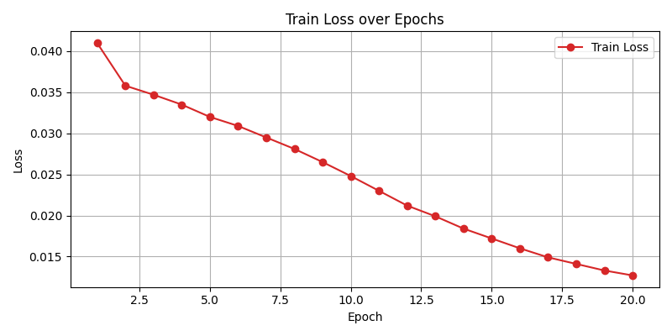
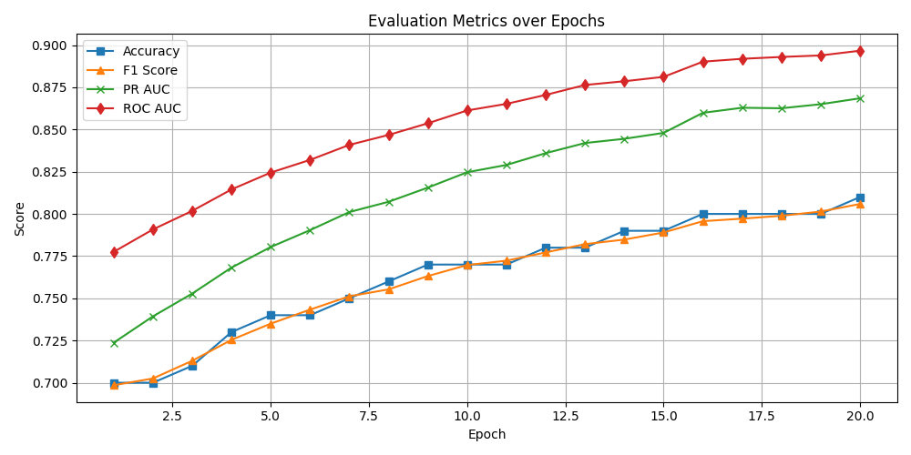
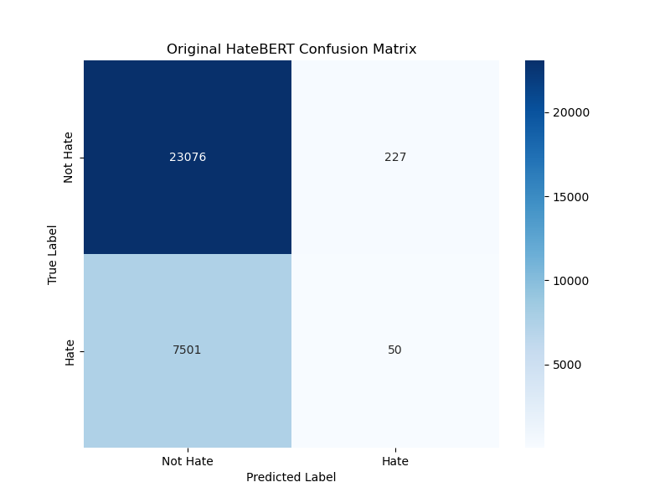
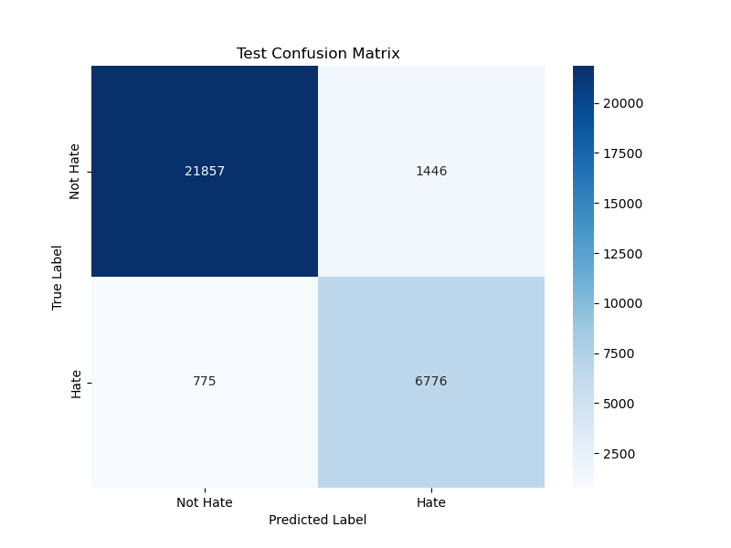
Fine-Tuning HateBERT for Hate Speech Classification
REPLACE THIS BOX WITH YOUR ORGANIZATION’S
HIGH RESOLUTION LOGO
REPLACE THIS BOX WITH YOUR ORGANIZATION’S
HIGH RESOLUTION LOGO
Victor-Andrei Căbulea, Marian Flămînzanu-Mateiuc
Technical University Gheorghe Asachi Iasi, Faculty of Automatic Control and Computer Engineering
Abstract
Fine-Tuning Process
This study examines the benefits of further fine-tuning the HateBERT model for hate speech classification. While it increases computational cost, fine-tuning can significantly boost the accuracy, demonstrating the value of task-specific adaptation of pre-trained language models for nuanced NLP tasks like hate speech detection.
The model is initialized with the pretrained HateBERT architecture, configured for binary classification. Dropout rates of 0.2 are applied to both attention and hidden layers to reduce overfitting. Initially, all transformer encoder layers except the last (12th) are frozen to preserve general language understanding, while the final and embedding layers remain trainable for task-specific adaptation. Training uses the AdamW optimizer with a learning rate of 2e-5 and weight decay of 1e-4 for regularization. A linear learning rate schedule with warm-up over the first 10% of steps gradually increases the rate from zero to the base value, then decays it to stabilize training. Batches of size 32 are used with gradient accumulation equal to 2, simulating an effective batch size of 64 within hardware limits. Gradient clipping with a max norm of 1.0 prevents exploding gradients. Early stopping with a patience of 3 epochs halts training when validation performance plateaus.
A gradual unfreezing strategy incrementally unlocks transformer layers to prevent catastrophic forgetting and overfitting, enabling deeper adaptation over time. During fine-tuning, validation is performed after each epoch using metrics such as macro F1-score, ROC AUC, and Precision-Recall AUC. Final evaluation on a held-out test set assesses generalization.
To address class imbalance, a custom Focal Loss function (α = 0.25, γ = 2.0) is used, focusing on hard-to-classify examples, unlike standard cross-entropy which assumes balanced classes.
The classification is realized by tokenizing the input using a pretrained subword tokenizer with truncation and padding to 128 tokens, balancing memory efficiency and context retention. In the forward pass, the model outputs logits—raw confidence scores—which are scaled by a temperature of 0.7 to sharpen the probability distribution for clearer decisions in sensitive cases. The softmax function converts logits into class probabilities. A binary decision is made using a threshold of 0.5: if the hate probability exceeds this value, the instance is labeled ‘Hate’; otherwise, ‘Not Hate’.
Introduction
Chart 1. Evolution of the train loss.
Online platforms enable communication but are challenged by hate speech such as harmful, discriminatory language, making effective automated detection truly important. This project fine-tunes HateBERT to build a reliable binary hate speech classifier for social platforms, aiming to reduce harmful content and protect vulnerable users.
Detection has evolved from traditional machine learning to deep learning, with transformers like BERT improving context understanding. Advanced models such as RoBERTa, ALBERT, and HateBERT enhance accuracy, while hybrid models with CNNs or RNNs can better capture semantics. Models like ToxicBERT and T5 support more nuanced moderation [1],[2],[3],[4].
While improvements have been made, there are still key challenges, such as reducing bias, and improving cross-domain generalization.
Chart 2. Evolution of the metrics during the training.
Data Preprocessing
We integrated four hate speech and offensive language datasets: HateXplain, Davidson, OLID, and SBIC [5][6],[7]. We applied operations such as deduplication, lowercasing, Unicode normalization, and removal of non-ASCII characters and special tokens (usernames, URLs, hashtags, hyperlinks). Common contractions were expanded, and regex-based replacements standardized informal language and slang. Character repetitions were normalized using a vocabulary-aware method that preserved valid English words from NLTK. Irrelevant punctuation, extra whitespace, and malformed characters were removed, retaining basic punctuation for clarity. WordNet-based synonym replacement augmented data by substituting contextually appropriate synonyms. Text was tokenized using the WordPiece tokenizer, splitting into semantically meaningful subwords. Inputs were truncated or padded to a fixed length of 128 tokens for balanced efficiency and coverage.
Figure 1. Original HateBERT Confusion Matrix on testing dataset
Results
When tested using the test set (which contains 33,508 samples), the model achieved an overall accuracy of 81%, a macro F1-score of 0.8062, a PR AUC of 0.8711, and a ROC AUC of 0.8967, indicating strong discriminative performance.
The following sentence was used as an example:
‘I genuinely despise everything you stand for --- your presence, your opinions, your entire way of life disgusts me to my core’.
The fine-tuned version of HateBERT classified this sentence as hateful speech, assigning a hate probability of 86.82%. The original HateBERT also labeled it as ‘Hate’, but with a lower hate probability of 59.67%.
The Mistral model was used as a judge and provided the following explanation:
‘The prediction is accurate as the text expresses strong negative emotions towards the speaker's opinions and way of life, indicating a potential for hate speech. The use of the word ‘despise’ and phrases like ‘our presence’ and ‘your entire way of life’ suggest a deep-seated hatred. Based on these factors, this text meets the criteria for hate speech.’
Mistral Model as a Judge
The Mistral-7B-Instruct-v0.1 model, a state-of-the-art open-weight language model, is used to post-evaluate classifier outputs. A tailored prompt includes the input text, predicted label, and hate probability, framing the model as a hate speech expert with structured input and clear instructions. It assesses classification accuracy, considers tone and context, explains its reasoning, and delivers a final verdict: ‘HATE’ or ‘NOT HATE’. This natural-language explanation enhances transparency, accountability, and trust. Inference uses temperature = 0.7 to control randomness and top_p = 0.9 to ensure coherent yet diverse responses via nucleus sampling.
Figure 2. Test Confusion Matrix for the Fine-Tuned HateBERT Model.
Conclusion
This project highlights the effectiveness of transformer-based models for hate speech detection by fine-tuning HateBERT on domain-specific data and comparing it to the original version. Fine-tuning significantly improved the model’s ability to detect nuanced hateful language, yielding superior classification performance. These results confirm that combining domain-adaptive pretraining with targeted fine-tuning improves both the robustness and accuracy of hate speech detection models.
Contact
References
Victor-Andrei Căbulea, Marian Flămînzanu-Mateiuc
Technical University Gheorghe Asachi Iasi,
Faculty of Automatic Control and Computer Engineering
Email: {victor-andrei.cabulea, marian.flaminzanu-mateiuc}@student.tuiasi.ro
Y. Liu et al., “RoBERTa: A robustly optimized BERT pretrainingapproach,” arXiv preprint arXiv:1907.11692, 2019.
T. Caselli, V. Basile, J. Mitrovi´c, L. Kallmeyer, and J. Bos, “HateBERT:Retraining BERT for abusive language detection in English,” in Proc.5th Workshop on Online Abuse and Harms (WOAH), 2021.
Z. Zhang, D. Robinson, and J. Tepper, “Detecting hate speech on socialmedia: An analysis of model performance and robustness,” in Proc. 14thInt. AAAI Conf. Web Social Media, 2018.
C. Li, D. Jin, X. Ren, and Q. Yu, “Towards explainable hate speechdetection with hybrid CNN-LSTM and attention mechanisms,” IEEETrans. Comput. Social Syst., 2021.
B. Mathew, P. Saha, S. M. Yimam, C. Biemann, P. Goyal, andA. Mukherjee, “HateXplain: A benchmark dataset for explainable hatespeech detection,” in Proc. AAAI Conf. on Artificial Intelligence, 2021.
T. Davidson, D. Warmsley, M. Macy, and I. Weber, “Automated hatespeech detection and the problem of offensive language,” in Proc. 11thInt. AAAI Conf. on Web and Social Media (ICWSM), Montreal, Canada,2017, pp. 512–515.
M. Sap, S. Gabriel, L. Qin, D. Jurafsky, N. A. Smith, and Y. Choi,“Social bias frames: Reasoning about social and power implications oflanguage,” in Proc. 58th Annu. Meeting of the Assoc. for ComputationalLinguistics (ACL), Online, 2020, pp. 5477–5490.

